Slide 1
Microcracking Indicators predict Critical Failure in Berea Sandstone Analogs
Harsh Biren Vora
Group Meeting, February 18th 2019

Slide 2
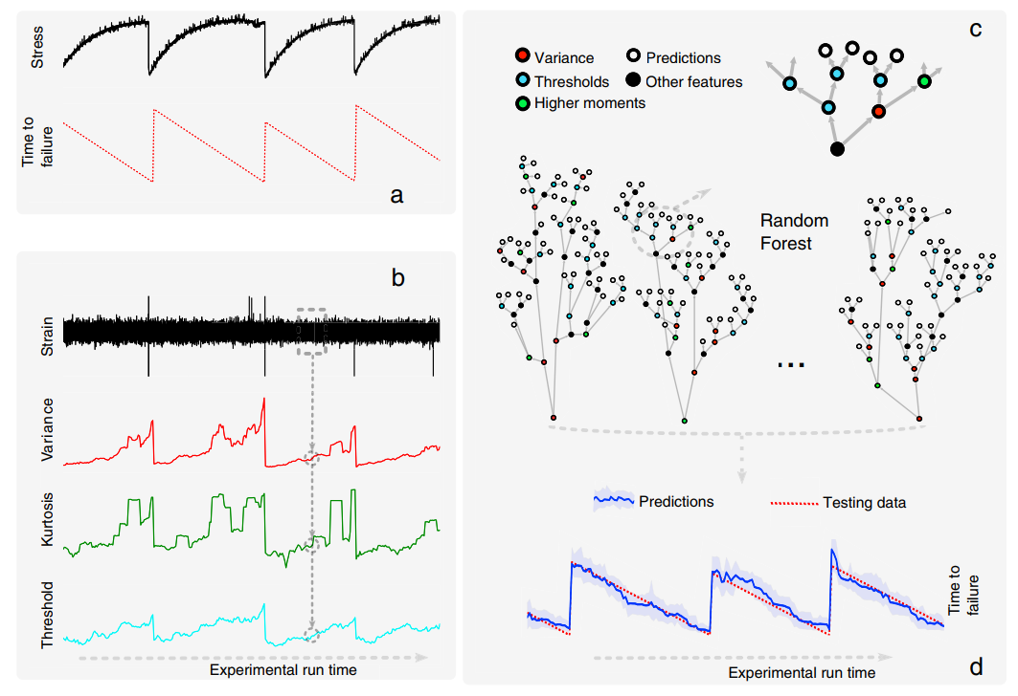
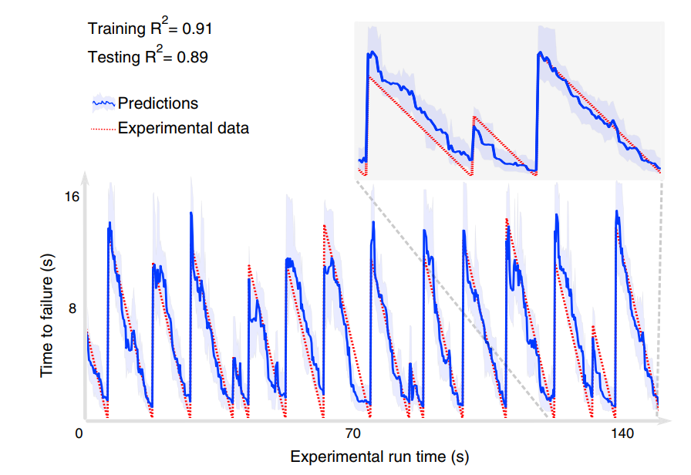
ML predicts failure in stick-slip experiments
Rouet-Leduc et al., 2017:
Variance of AE energy shows strongest correlation
AI can be used to predict time to failure
Notes:
But
1. they used it on pre-fractured rock and failure is a function of friction.
2. They only use knowledge of fracture energy

Slide 3
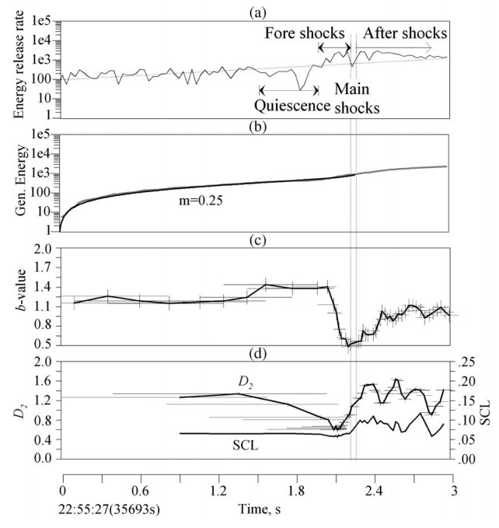
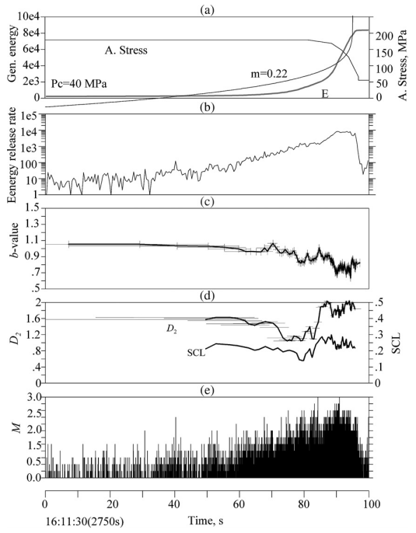
Critical Failure Indicators (Lei et al., 2006)
Granite
schist
Prior to failure:
Increase in Energy Release Rate
Decline in b-values
Decline in D-values
Notes:
Identify various precursors
But do not build a predictive tool

Slide 4
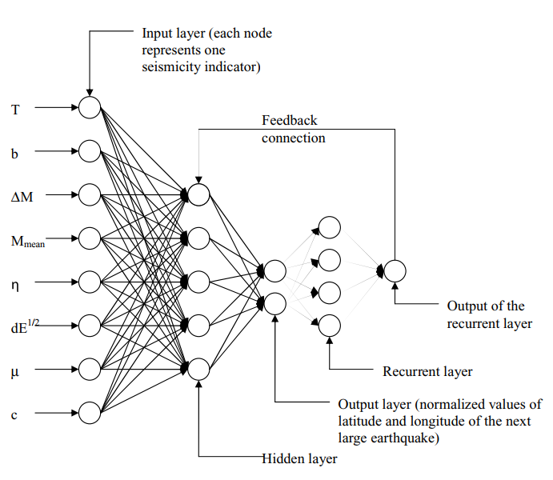
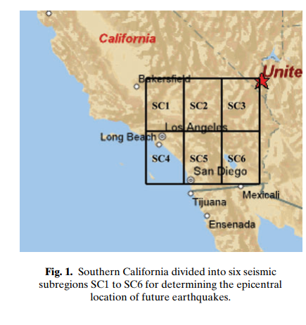
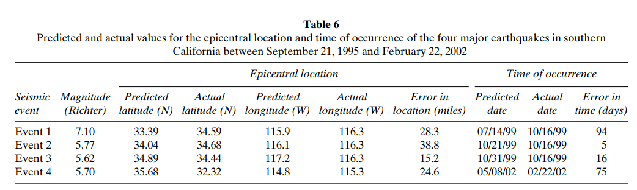
Earthquake Prediction
Time
b-value
Moment deficit
Mean Moment
Deviation from GBR
Sqrt(Seismic energy)
Characteristic time
Coefficient of variation
of mean time
Pannakat and Adeli, 2008

Slide 5
Objectives
“Several parameters are functions of the temporal distance to the critical point”
“An integrated analysis of two or more parameters may lead to more effective means of predicting time of the critical point”
Quantify indicators of critical failure in granular rock
Can they be combined to build a predictive tool?
Lei et al., 2006

Slide 6
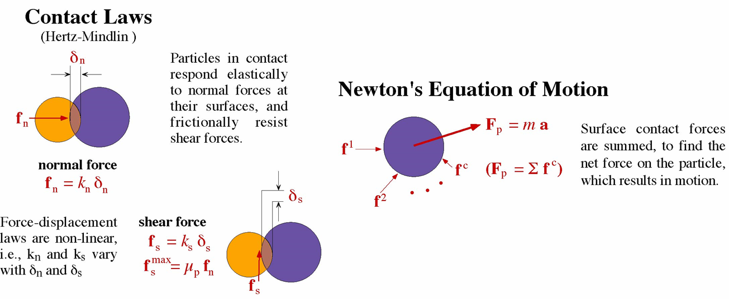

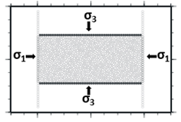
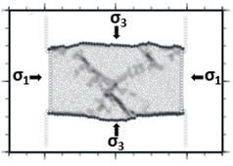
Experiments using Discrete Element Method
σ_{pre}
Induced Bonds can fail in different modes:
Tensile
Shear
Rotation

Slide 7
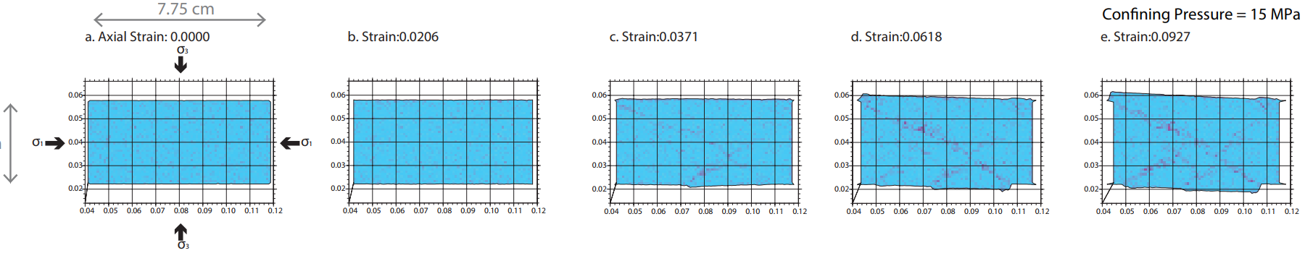

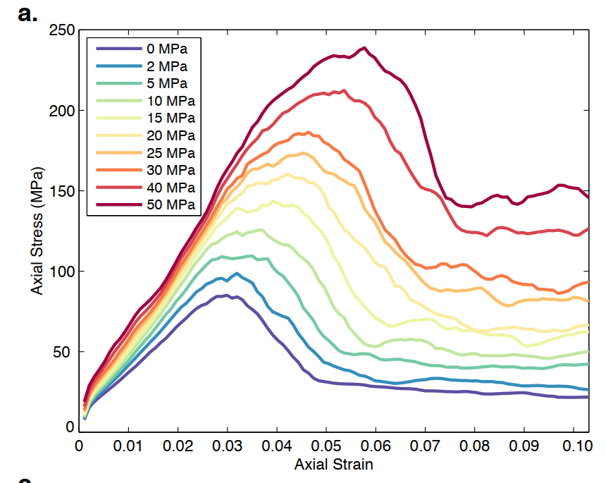
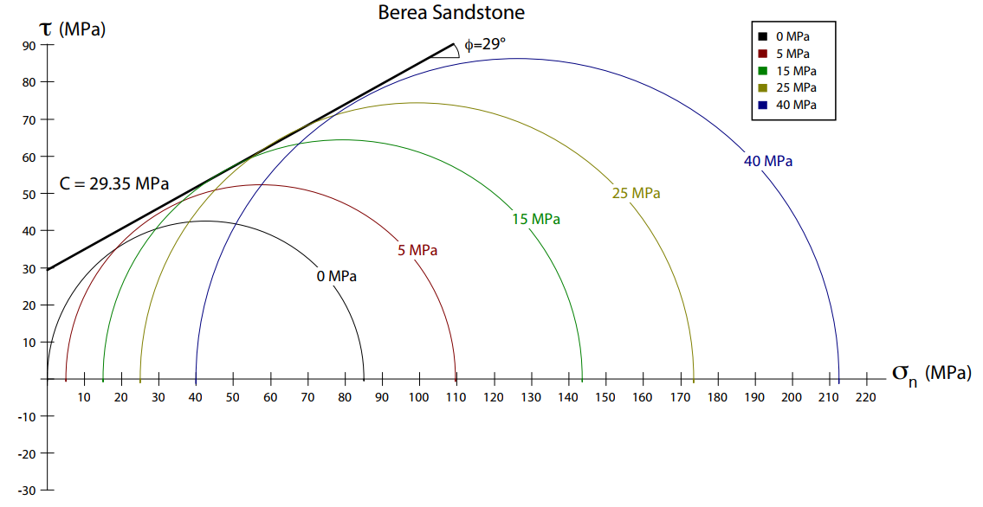
Biaxial Experiments on Berea Sandstone
3 .8 cm
Parameter | Modeled | Experimental
UCS (MPa) | 85.05 | 95.00
Young’s Modulus (Pa) | 6.28 | 7.50
MC Cohesion (Pa) | 29.35 | 26.10
MC Slope | 0.55 | 0.49

Slide 8
Independent Damage Indicators
1. Microcrack Growth:
Microcracking rate [Lubbers et al., 2018]
Microcracking variance [Rouet-Leduc et al., 2017]
p-value (Omori’s Law) [Avila-Barrientos et al., 2015]
2. Microcrack Mode: Shear, tensile and pore collapse [Fortin et al., 2009]
3. Damage Distribution: Fractal Dimension of microcracks [Hirata et al., 1987]
4. Acoustic Energy:
AE energy release rate [Lei et al., 2006]
AE energy variance [Rouet-Leduc et al., 2017]
5. Seismic Moment:
Range of Seismic moments [Kagan and Knopoff, 1978]
b-value [Florido et al., 2015; Reviere et al., 2018]

Slide 9
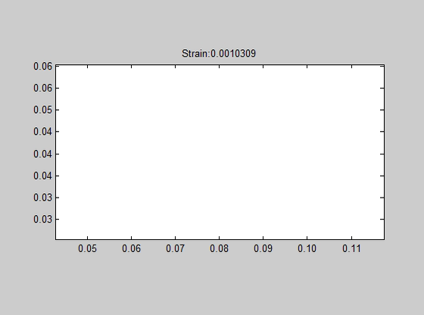
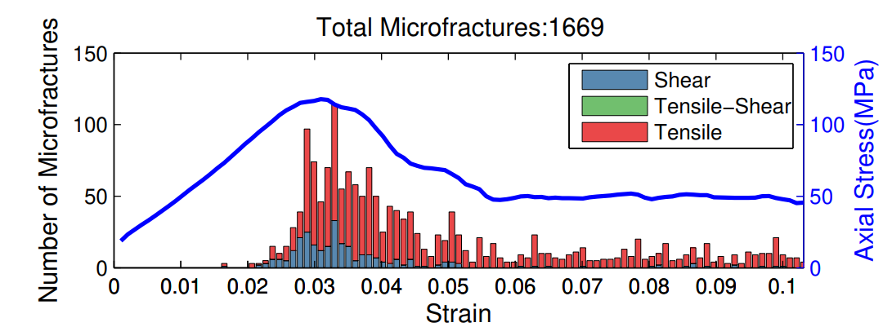
Method 1: Microcrack Growth
3 .8 cm

Slide 10
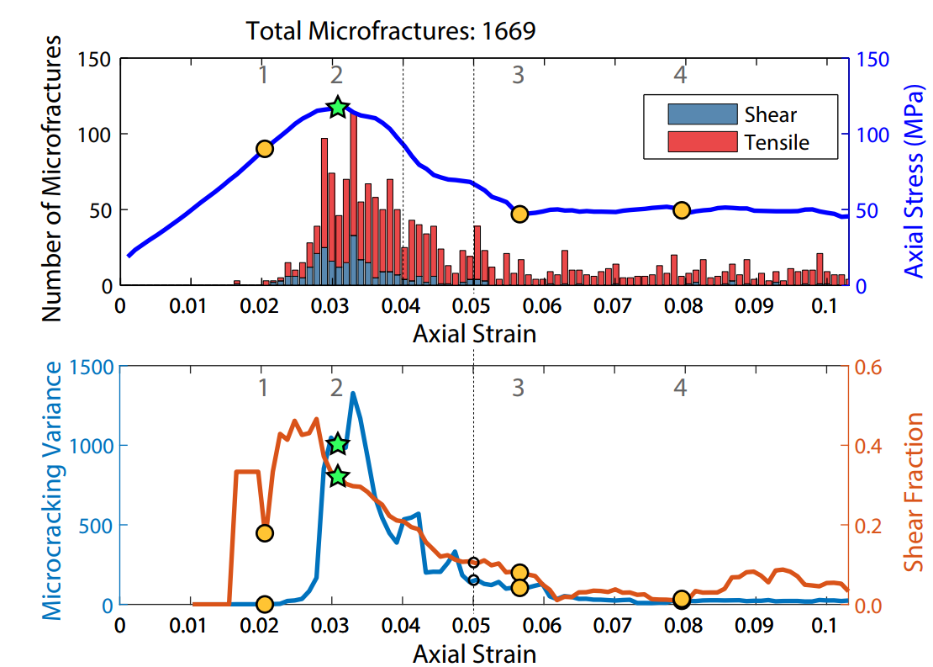
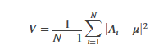
Indicator 1: Microcracking Variance
Variance: Expectation of deviation from Mean
Prior to critical point: Large increase in number of microcracks (and variance)
After critical point: Steep decline in microcracking variance

Slide 11
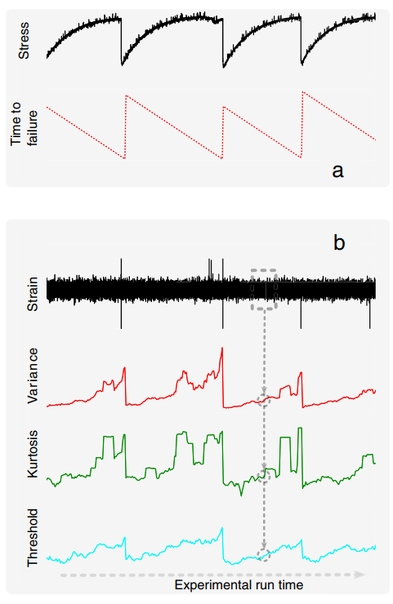
Indicator 1: Microcracking Variance

Slide 12
Indicator 2: Shear Fraction
Shear Fraction:
SF = Shear Microcracks/ Total Microcracks
Prior to critical point: Peak Shear Fraction attained prior to failure
After critical point: Constant decline in Shear Fraction

Slide 13
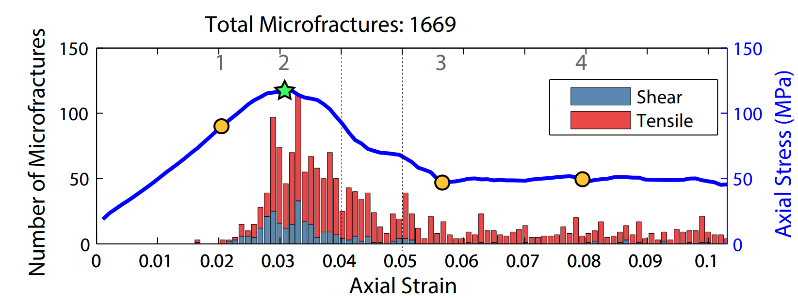
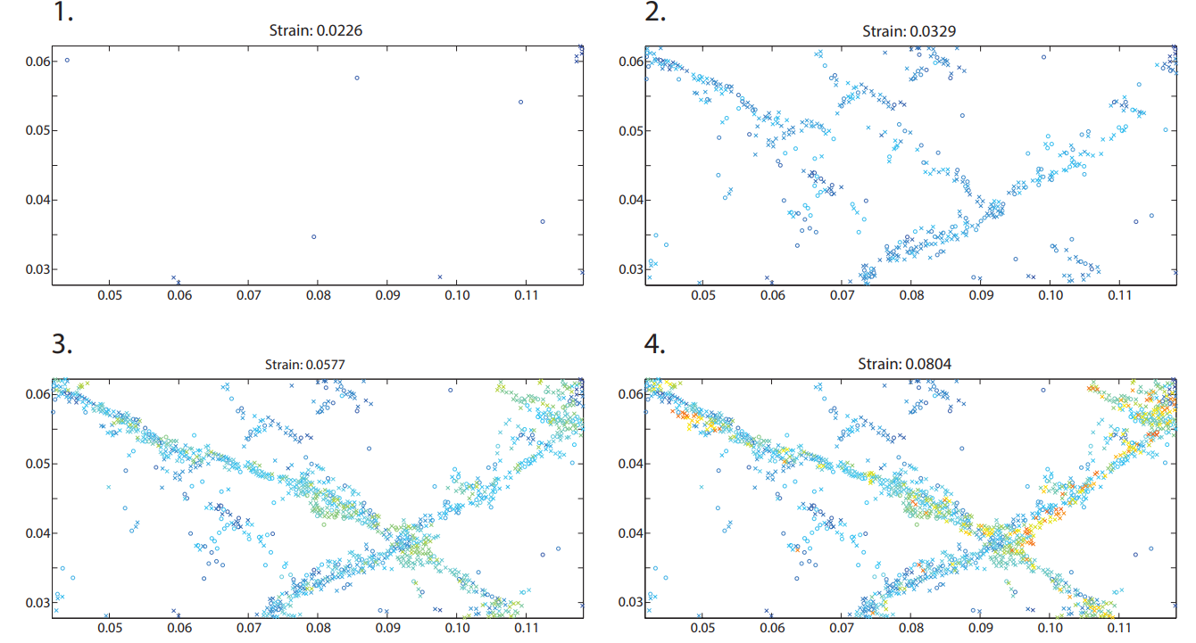
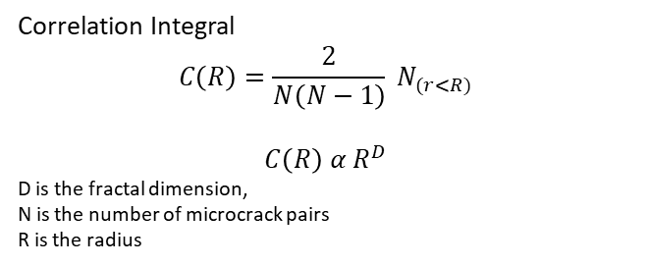
Indicator 3: Fractal Dimension
Correlation Integral
$$C\left(R\right)=\frac{2}{N\left(N−1\right)} N_{(r<R)}$$
$$C\left(R\right) α R^{D}$$
D is the fractal dimension,
N is the number of microcrack pairs
R is the radius
High D-value: Distributed Damage
Low D-value: Localized Damage

Slide 14
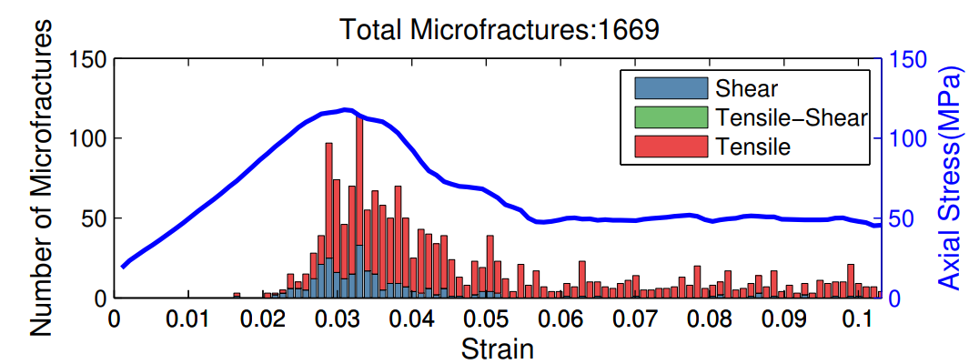
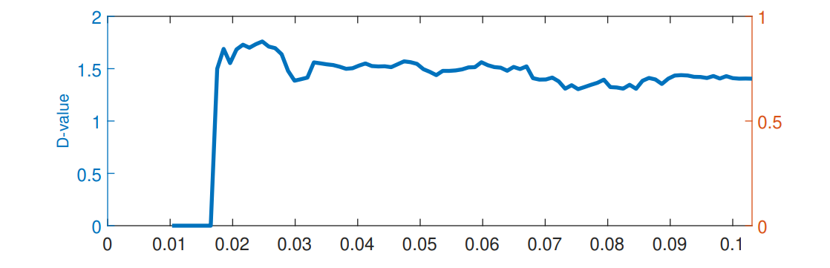
Indicator 3: Fractal Dimension
2
1
Fractal Dimension (D) is a measure of spatial distribution of microcracks
3
4
1
Prior to critical point: Decline in calculated D-value
After critical point: Slight increase and stable D-value
2
3
4

Slide 15
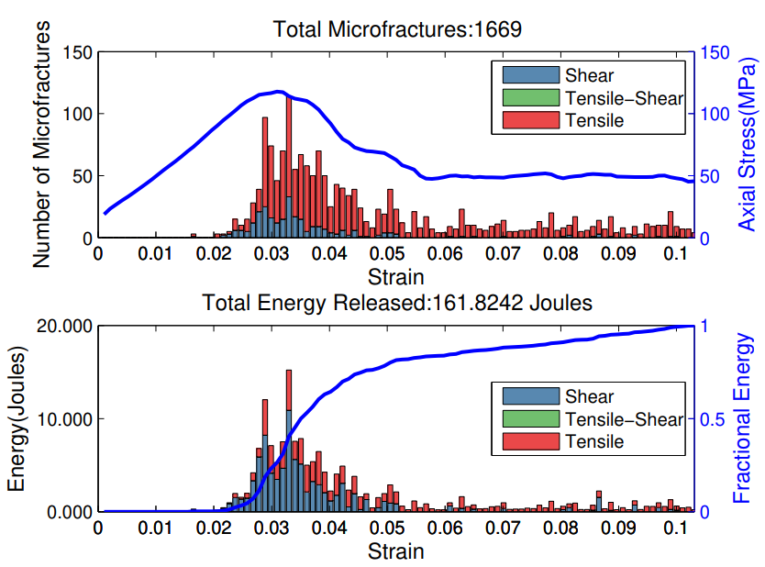
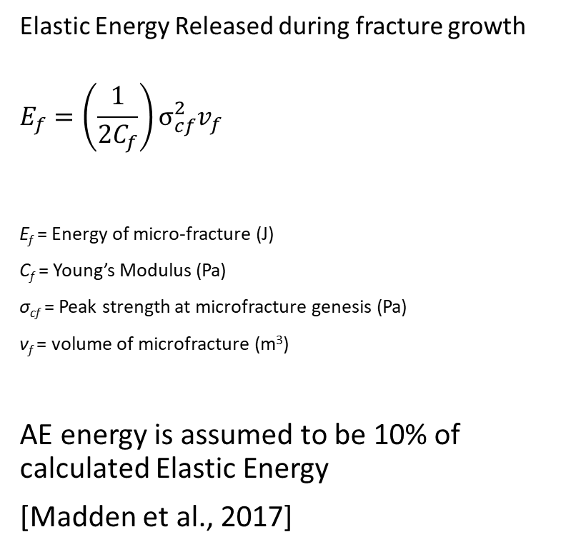
Acoustic Energy
Elastic Energy Released during fracture growth
$$E_{f}=\left(\frac{1}{2C_{f}}\right)σ_{cf}^{2}v_{f}$$
E_{f} = Energy of micro-fracture (J)
C_{f} = Young’s Modulus (Pa)
σ_{cf} = Peak strength at microfracture genesis (Pa)
ν_{f} = volume of microfracture (m³)
AE energy is assumed to be 10% of calculated Elastic Energy
[Madden et al., 2017]

Slide 16
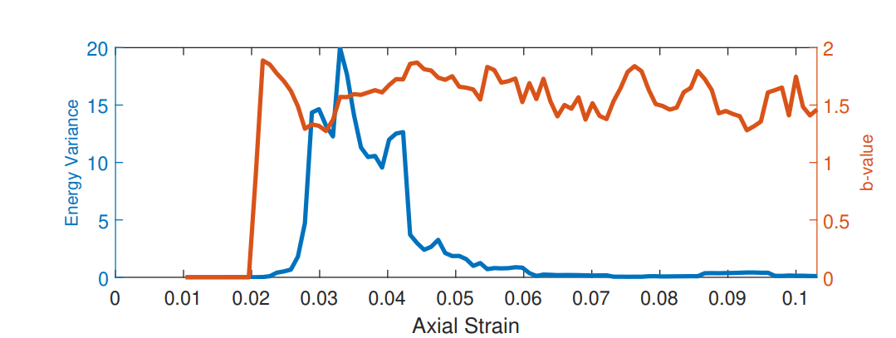
Indicator 4: AE Energy Variance
2
1
3
4
Variance: Expectation of deviation from Mean
3
4
2
1
Prior to critical point: Large increase in microcrack energy (and variance)
After critical point: Increase and then decline in microcrack energy (and variance)
2
1
3
4

Slide 17

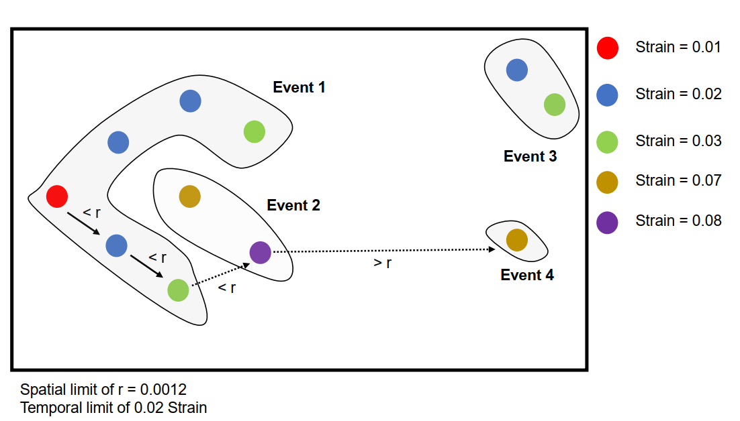
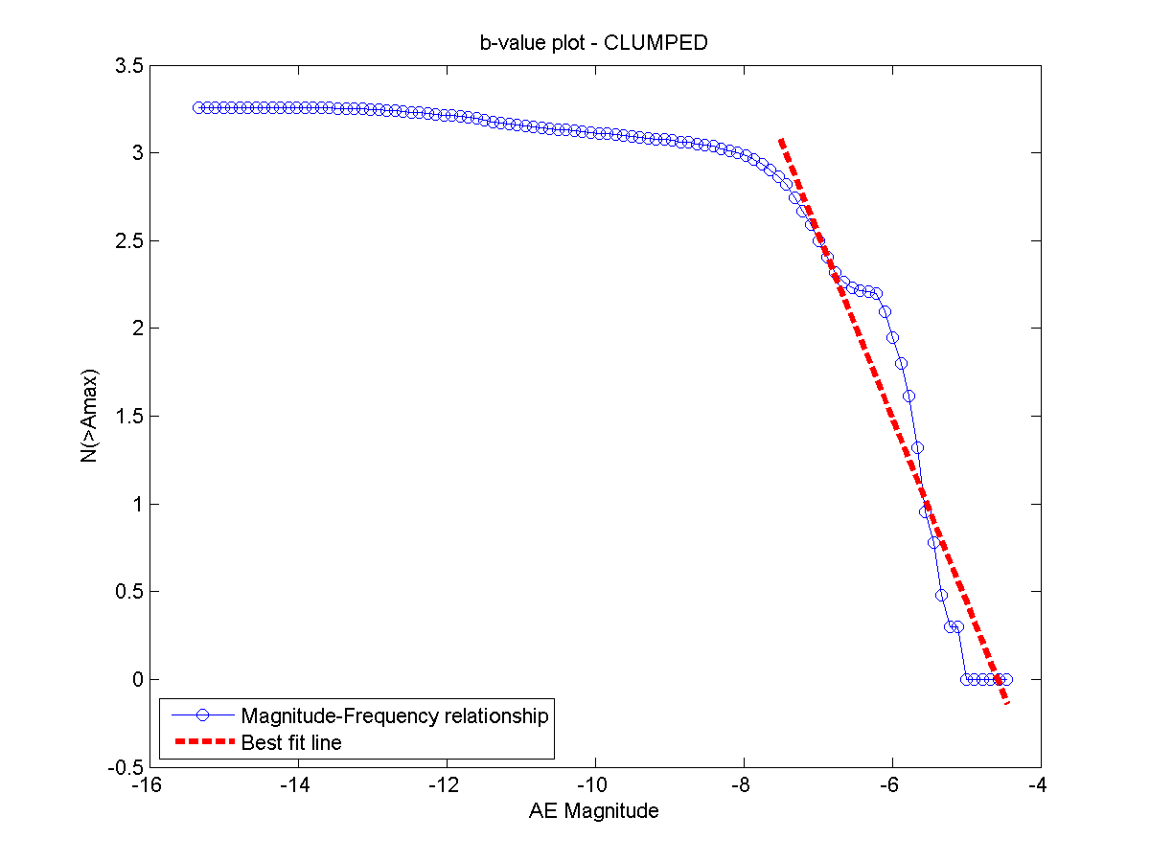
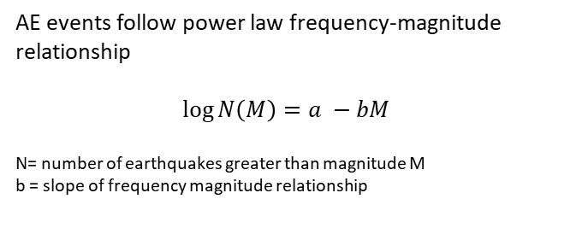
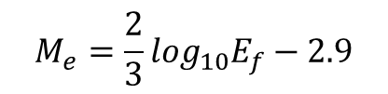
Moment Magnitude
Spatial and Temporal clustering of Microcracks
AE events follow power law frequency-magnitude relationship
$$\log{N\left(M\right)=a −bM}$$
N= number of earthquakes greater than magnitude M
b = slope of frequency magnitude relationship
$$M_{e}=\frac{2}{3}\log_{10}E_{f}−2.9$$

Slide 18
Indicator 5: b-value
2
1
3
4
b-values are indicative of moment distribution during deformation experiments
3
4
2
1
Prior to critical point: Drop in b-value
After critical point: Increase and then relatively stable b-values
3
2
4
1

Slide 19
Effect of Confining Pressure
Range of variance decreases with confining pressure
Microcracking variance peaks at critical point and declines after failure
Shear Fraction increases with confining pressure
Shear Fraction peaks prior to critical point and declines after failure
D-value increases with confining pressure
D-value declines shortly before critical point and stabilizes after failure

Slide 20
Effect of Confining Pressure
Range of variance increases with confining pressure
Energy variance is high at critical point and declines after failure
b-values decline with confining pressure
b-values decline around critical point from an initially higher value

Slide 21
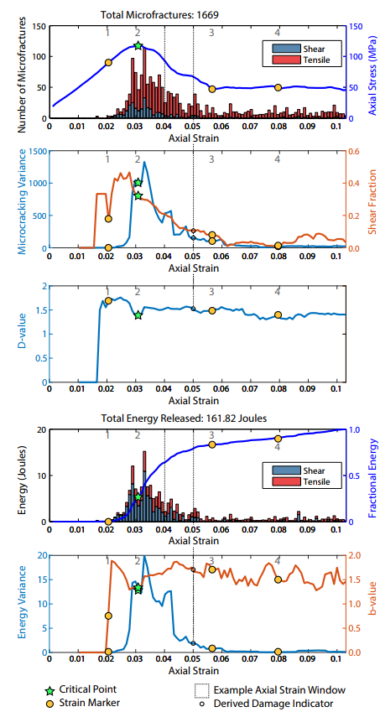
Summary of Damage Indicators
Indicators of critical point from biaxial experiments (0-50 MPa) :
High variance in microcracking
Peak Shear Fraction
High variance in microcrack energy
Low b-values
Low D-values

Slide 22

Predicting Critical Failure using Neural Networks
6 Inputs:
Microcracking Variance
Microcracking Shear Fraction
Fractal Dimension (D-value)
Microcrack AE Energy Variance
b-value
Confining Pressure
Outputs:
Axial Stress to Failure
Axial Strain to Failure

Slide 23
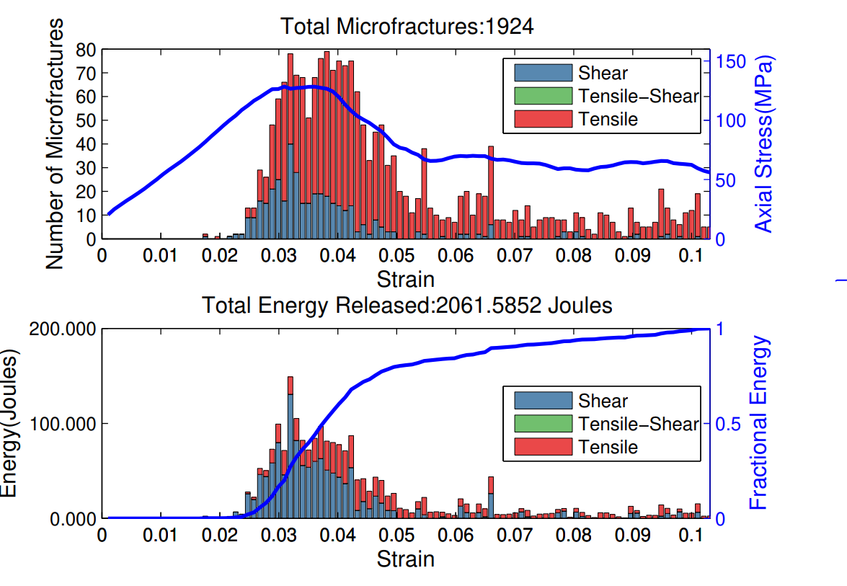
Predicting Rock Failure using Neural Networks
Axial Stress to Failure
Axial Strain to Failure
Inputs from 0 to 50 MPa:
Microcracking variance
Energy variance
Seismic b-value
Shear Fraction
Fractal Dimension
Input dataset: [91 (samples) x10 (experiments)] x 6 (parameters)
[910 x 6]
Training: 70% of Dataset
Testing: 30% of dataset

Slide 24
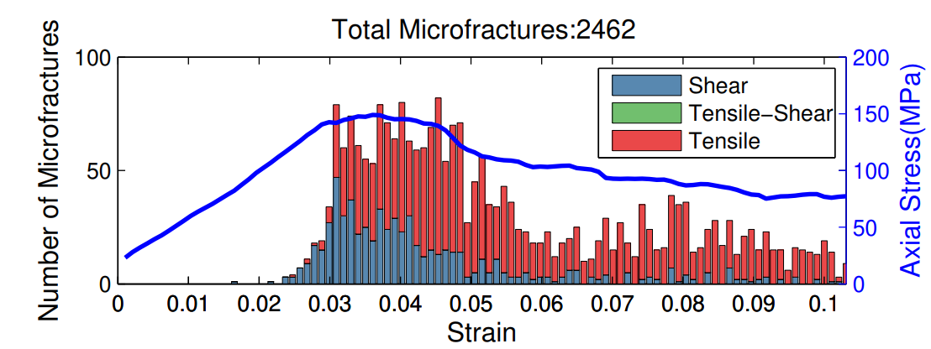
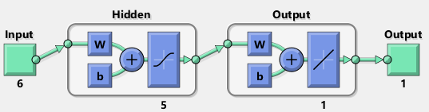
Predicting Axial Stress to Failure using ANN
Targets
Training Predictions
Testing Predictions

Slide 25
Blind Test: 25 MPa Experiment
Post-failure
Pre-failure

Slide 26
Predicting Axial Strain to Failure using ANN
Targets
Training Predictions
Testing Predictions

Slide 27
Blind Test: 25 MPa Experiment
Post-failure
Pre-failure

Slide 28

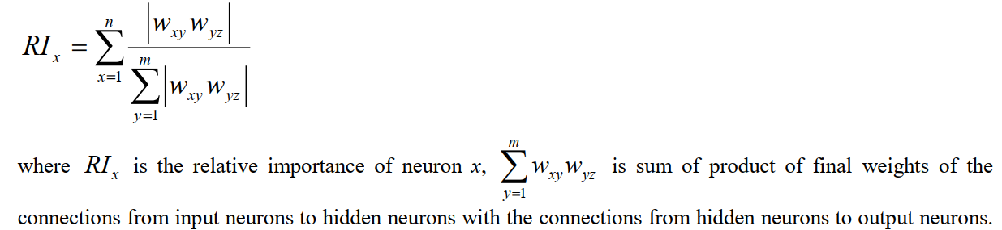
Relative Importance of Input Parameters
Damage Indicators:
Microcracking
Fractal Dimension
Microcracking Energy
Shear Fraction
Seismic b-value

Slide 29
Relative Importance of Input Parameters
Microcrack variance shows most importance for critical point predictions
Shear Fraction, b-value and Fractal dimension are relatively important parameters for prediction too
Energy Variance and confining pressure shows least importance for critical point predictions

Slide 30
Summary
Quantified damage indicators:
Microcrack Growth (Microcrack Variance)
Microcrack Source mechanism (Shear Fraction)
Fracture Energy (AE Energy Variance)
Spatial Distribution of Microcracks (D-value)
Moment magnitude (b-value and Moment Range)
Damage indicators can be used to predict stress-to-failure and strain-to-failure using Artificial Neural Networks
Variance of microcrack growth is the most important parameter for failure prediction.

Slide 31
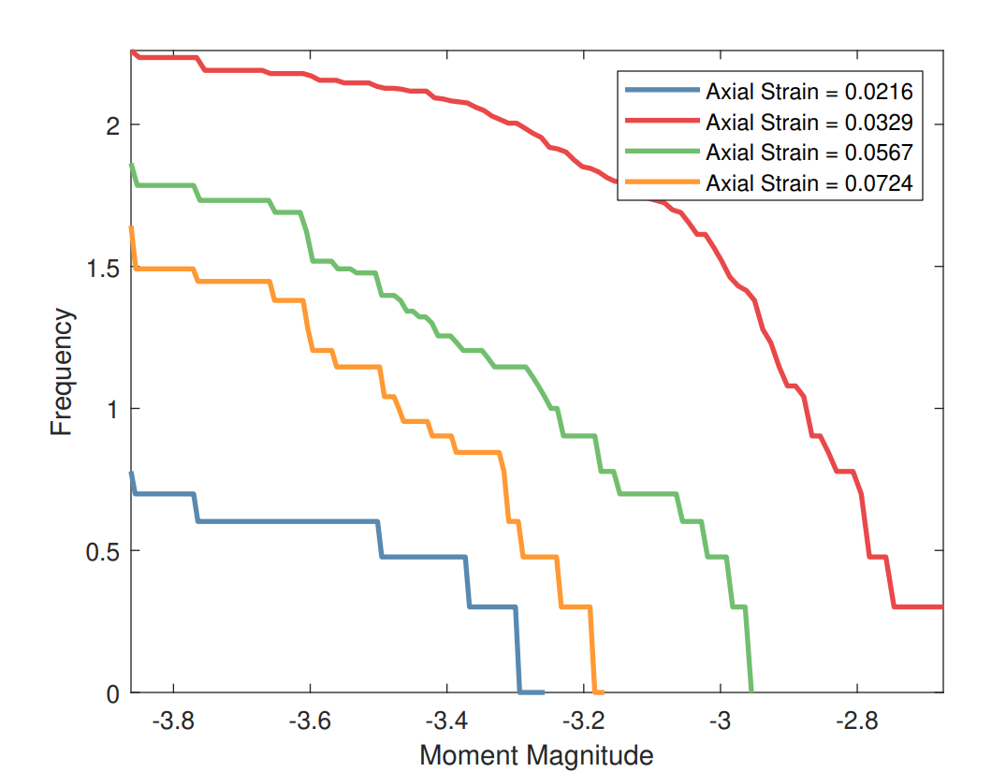
b-value evolution
2
1
3
4

